Slide 1
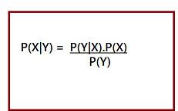
UNIT - V
Bayesian Learning: Probability theory and Bayes rule
Bayes Theorem
Bayes theorem is one of the most popular machine learning concepts that helps to calculate the probability of occurring one event with uncertain knowledge while other one has already occurred.
Bayes' theorem can be derived using product rule and conditional probability of event X with known event Y:
According to the product rule we can express as the probability of event X with known event Y as follows;
Mathematically, Bayes theorem can be expressed by combining both equations on right hand side. We will get:

Slide 2
The above equation is called as Bayes Rule or Bayes Theorem.
P(X|Y) is called as posterior, which we need to calculate. It is defined as updated probability after considering the evidence.
P(Y|X) is called the likelihood. It is the probability of evidence when hypothesis is true.
P(X) is called the prior probability, probability of hypothesis before considering the evidence
P(Y) is called marginal probability. It is defined as the probability of evidence under any consideration.
Naive Bayes learning algorithm
Naïve Bayes algorithm is a supervised learning algorithm, which is based on Bayes theorem and used for solving classification problems.
It is mainly used in text classification that includes a high-dimensional training dataset.
Naïve Bayes Classifier is one of the simple and most effective Classification algorithms which helps in building the fast machine learning models that can make quick predictions.
It is a probabilistic classifier, which means it predicts on the basis of the probability of an object.

Slide 3
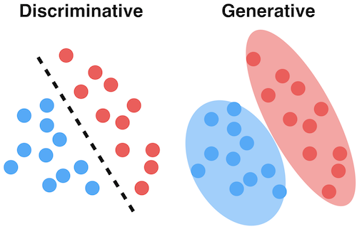
Generative vs. discriminative training
Generative Models
Generative models are models where the focus is the distribution of individual classes in a dataset and the learning algorithms tend to model the underlying patterns/distribution of the data points. These models use the intuition of joint probability in theory, creating instances where a given feature (x)/input and the desired output/label (y) exist at the same time.

Slide 4
Examples of machine learning generative models
Naive Bayes (and generally Bayesian networks)
Hidden Markov model
Linear discriminant analysis (LDA), a dimensionality reduction technique
Discriminative Models
Discriminative models, also called conditional models, tend to learn the boundary between classes/labels in a dataset. Unlike generative models, the goal here is to find the decision boundary separating one class from another.
Examples of discriminative models in machine learning are:
Logistic regression
Support vector machine
Decision tree
Random forest

Slide 5
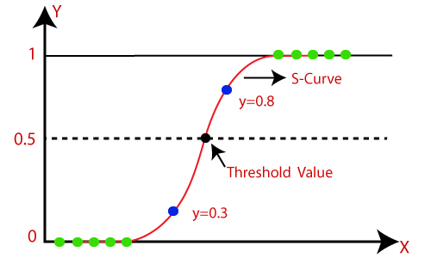
Logisitic regression
Logistic regression is one of the most popular Machine Learning algorithms, which comes under the Supervised Learning technique. It is used for predicting the categorical dependent variable using a given set of independent variables.
Logistic regression predicts the output of a categorical dependent variable. Therefore the outcome must be a categorical or discrete value. It can be either Yes or No, 0 or 1, true or False, etc. but instead of giving the exact value as 0 and 1, it gives the probabilistic values which lie between 0 and 1.
The curve from the logistic function indicates the likelihood of something such as whether the cells are cancerous or not, a mouse is obese or not based on its weight, etc.

Slide 6


Logistic Regression Equation:
The Logistic regression equation can be obtained from the Linear Regression equation. The mathematical steps to get Logistic Regression equations are given below:
We know the equation of the straight line can be written as:
In Logistic Regression y can be between 0 and 1 only, so for this let's divide the above equation by (1-y):
But we need range between -[infinity] to +[infinity], then take logarithm of the equation it will become:
The above equation is the final equation for Logistic Regression.

Slide 7
Bayes nets and Markov nets for representing dependencies
BAYESIAN
A Bayesian network, Bayes network, belief network, Bayes(ian) model or probabilistic directed acyclic graphical model is a probabilistic graphical model (a type of statistical model) that represents a set of random variables and their conditional dependencies via a directed acyclic graph (DAG).
MARKOV
An example of a Markov random field. Each edge represents dependency. In this example: A depends on B and D. B depends on A and D. D depends on A, B, and E. E depends on D and C. C depends on E.
A Markov network or MRF is similar to a Bayesian network in its representation of
dependencies; the differences being that Bayesian networks are directed and acyclic,
whereas Markov networks are undirected and may be cyclic.

Slide 8
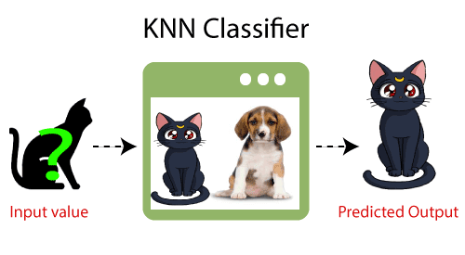
K-Nearest Neighbor(KNN) Algorithm for Machine Learning
K-Nearest Neighbour is one of the simplest Machine Learning algorithms based on Supervised Learning technique.
K-NN algorithm assumes the similarity between the new case/data and available cases and put the new case into the category that is most similar to the available categories.
K-NN algorithm stores all the available data and classifies a new data point based on the similarity. This means when new data appears then it can be easily classified into a well suite category by using K- NN algorithm.
It is also called a lazy learner algorithm because it does not learn from the training set immediately instead it stores the dataset and at the time of classification, it performs an action on the dataset.
Example: Suppose, we have an image of a creature that looks similar to cat and dog, but we want to know either it is a cat or dog. So for this identification, we can use the KNN algorithm, as it works on a similarity measure.

Slide 9
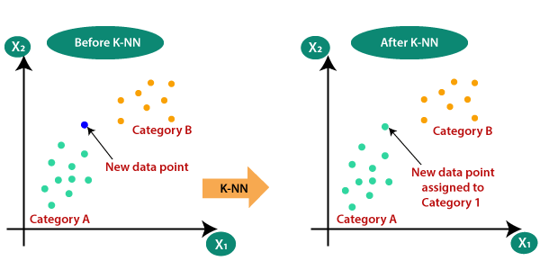
Why do we need a K-NN Algorithm?
Suppose there are two categories, i.e., Category A and Category B, and we have a new data point x1, so this data point will lie in which of these categories. To solve this type of problem, we need a K-NN algorithm. With the help of K-NN, we can easily identify the category or class of a particular dataset. Consider the below diagram:

Slide 10
How does K-NN work?
The K-NN working can be explained on the basis of the below algorithm:
Step-1: Select the number K of the neighbors.
Step-2: Calculate the Euclidean distance of K number of neighbors.
Step-3: Take the K nearest neighbors as per the calculated Euclidean distance.
Step-4: Among these k neighbors, count the number of the data points in each category.
Step-5: Assign the new data points to that category for which the number of the neighbor is maximum.
Step-6: Our model is ready.

Slide 11
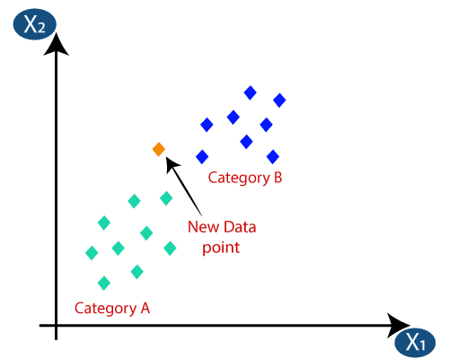
Suppose we have a new data point and we need to put it in the required category. Consider the below image:
Firstly, we will choose the number of neighbors, so we will choose the k=5.
Next, we will calculate the Euclidean distance between the data points. The Euclidean distance is the distance between two points, which we have already studied in geometry. It can be calculated as:

Slide 12
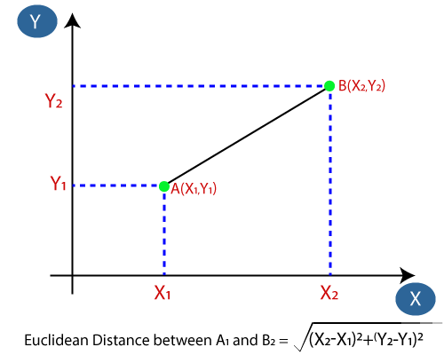
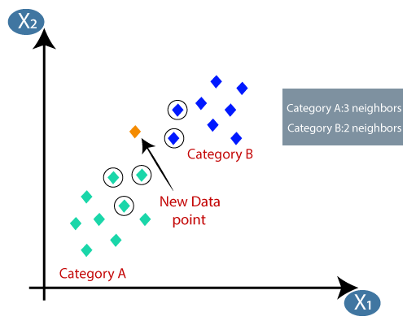
By calculating the Euclidean distance we got the nearest neighbors, as three nearest neighbors in category A and two nearest neighbors in category B. Consider the below image:

Slide 13
As we can see the 3 nearest neighbors are from category A, hence this new data point must belong to category A.
Advantages of KNN Algorithm:
It is simple to implement.
It is robust to the noisy training data
It can be more effective if the training data is large.
Disadvantages of KNN Algorithm:
Always needs to determine the value of K which may be complex some time.
The computation cost is high because of calculating the distance between the data points for all the training samples.

Slide 14
Case-based learning
As we know Nearest Neighbour classifiers stores training tuples as points in Euclidean space. But Case-Based Reasoning classifiers (CBR) use a database of problem solutions to solve new problems. It stores the tuples or cases for problem-solving as complex symbolic descriptions.
How CBR works?
When a new case arises to classify, a Case-based Reasoner(CBR) will first check if an identical training case exists. If one is found, then the accompanying solution to that case is returned. If no identical case is found, then the CBR will search for training cases having components that are similar to those of the new case. Conceptually, these training cases may be considered as neighbours of the new case.
Applications of CBR includes:
Problem resolution for customer service help desks, where cases describe product-related diagnostic problems.
It is also applied to areas such as engineering and law, where cases are either technical designs or legal rulings, respectively.
Medical educations, where patient case histories and treatments are used to help diagnose and treat new patients.

Slide 15
Challenges with CBR
Finding a good similarity metric (eg for matching subgraphs) and suitable methods for combining solutions.
Selecting salient features for indexing training cases and the development of efficient indexing techniques.
Instance-Based Learning
The Machine Learning systems which are categorized as instance-based learning are the systems that learn the training examples by heart and then generalizes to new instances based on some similarity measure.
It is called instance-based because it builds the hypotheses from the training instances. It is also known as memory-based learning or lazy-learning.
The time complexity of this algorithm depends upon the size of training data. Each time whenever a new query is encountered, its previously stores data is examined. And assign to a target function value for the new instance.

Slide 16
Advantages:
Instead of estimating for the entire instance set, local approximations can be made to the target function.
2. This algorithm can adapt to new data easily, one which is collected as we go
Disadvantages:
Classification costs are high
Large amount of memory required to store the data, and each query involves starting the identification of a local model from scratch.
Some of the instance-based learning algorithms are :
K Nearest Neighbor (KNN)
Self-Organizing Map (SOM)
Learning Vector Quantization (LVQ)
Locally Weighted Learning (LWL)
Case-Based Reasoning

